Slide 1
CAPSTONE PROJECT
Presented by Mekiran Srividhyadharsan
Please view the video recording with this link:
https://drive.google.com/file/d/1A7I3a02vFDH4xtVFcODzx8fHnYddIxDI/view?usp=sharing
Capstone Project folder Google Drive link:
https://drive.google.com/drive/folders/1zOjeaGSVjZw7ZUQJPc2NAjFy09H3ruoH
For any enquiries, please email: meksriv@gmail.com

Slide 2
Business Problem
People need to return to work, however bringing everyone back at the same time would only increase the spread of COVID-19 and endanger employees.
Employees who are less likely to die from COVID-19 should handle more in-person work over those who are more likely to die from COVID-19.
Employees could be concerned if they live with people who are high-risk even if they themselves are not.
Solution: A phased return to work from low-risk to high-risk employees
- NHS recommends this as one adjustment for employees to safely return to their workplace.
- In general, will reduce the number of people at the workplace, lowering the risk of spreading COVID-19 and making it easier to comply with social distancing rules.

Slide 3
Hypothesis
If age is the only significant risk factor, then the company should only prioritise by age.
I suspect age will be the most significant risk factor since the vaccination program in the UK is phased entirely by age.
By looking at multiple risk factors, we can determine how significant age is to other risk factors.

Slide 4
Method Selection - No
Model | Advantages | Disadvantages | Would it work well for this problem?
Linear Regression | Simple Easy to implement | Sensitive to outliers Data has to be independent, no correlation between the dependent variables | No, since we will be looking at multiple risk factors and they will influence each other (not independent to each other).
K-Means Clustering | Easy to understand Training results delivered quickly | Not as competitive as other clustering techniques | No, there are multiple risk factors with categorical data and clustering is limited to 2 numerical data at a time.
Support Vector Machines | Effective in high dimensional spaces Memory efficient Versatile | Does not provide probability estimates directly. Would have to use a five-fold cross-validation | No, runs well when output is classes (categorical) but our output will be probability estimates (numerical)

Slide 5
Method Selection - Yes
Model | Advantages | Disadvantages | Would it work well for this problem?
Decision Tree | Easy to interpret Does not require feature scaling Classification or Regression | Overfitting | Yes, specifically regression as we can have multiple risk factors as the input features and the measure of risk as the output variable. Feature Relative Importance can give an insight on which risk factor is important. Classification would require classes as the output variable which is harder to find in datasets.

Slide 6
Measuring Risk and Risk Factors
Risk Factors
Age
Gender
Pre-existing medical conditions
Obesity
Ethnicity
Profession
Location
Smoking
The best measure to tell how likely is it for someone to die from COVID-19 is Infection Fatality Rate:
Infection Fatality Rate = Total number of deaths/Total number of cases
e.g. 10 deaths in 10000 cases means that there is 0.1% Infection Fatality Rate.

Slide 7
Ideal Dataset and Anticipated Results
Ideally, a dataset would include multiple risk factors and the infection fatality rate as the output like so:
With a regression decision tree model, we can see which of the features are important through Feature Relative Importance.
If age had a larger Feature Relative Importance (e.g. 0.8) than others, we would accept the hypothesis.
If age was not larger than other features, we would reject the hypothesis.
However, its very hard to find data like this. It would require a lot of data collection and access to personal data.

Slide 8
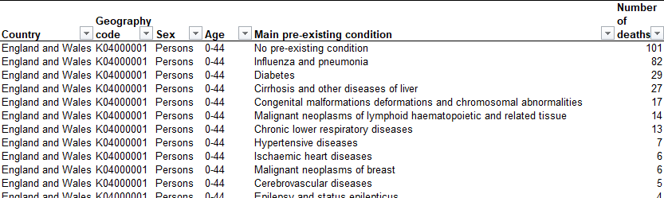
Best available data
Data is based on all the deaths in England and Wales between March and June 2020 split by gender, age and pre-existing medical condition.
This data was compiled by the Office of National Statistics
A total of 50,355 deaths happened in England and Wales.
This is a sample of the data found in Table 6a in the June dataset:

Slide 9
Measuring Risk
Since the number of cases is not known, but the number of deaths with known risk factors and the total number of deaths is known, I can use this to measure risk.
Take a look at this separate example:
Total deaths = 10000
Male and 50 years old = 1000 deaths
Female and 60 years old = 200 deaths
Proportion of deaths for Male and 50 years old = 1000/10000 = 0.1 = 10%
Proportion of deaths for Female and 60 years old = 200/10000 = 0.02 = 2%
10/2 = 5
In this example, Males who are 50 year olds were 5 times more likely to die than Females who are 60 year olds.

Slide 10
Exploratory Data Analysis – Age
Insight: More than 50% of COVID-19 deaths are represented in the top 3 age bands

Slide 11
Exploratory Data Analysis - Sex
Insight: Similar to other diseases, males are were 10% more likely to die from COVID-19 than females .

Slide 12
Exploratory Data Analysis – Main pre-existing medical conditions
Insights:
The 3 main pre-existing conditions listed above collectively represent nearly half of the deaths to COVID-19
Each had a higher proportion of COVID-19 deaths compared to no pre-existing conditions.

Slide 13
Evaluating the model
R-squared | Coefficient of determination. Determines the proportion of variance in the dependent variable that can be explained by the independent variable. ‘Goodness of fit’ measure.
RMSE | Root Mean Square Error is the standard deviation of the residuals. Residuals are a measure on how far the data points are to the regression line. RMSE tells you how spread out the residuals are and how concentrated the data is to the line of best fit.
Random Forest | A large number of decision trees that operate as an ensemble. Each individual tree in the random forest returns a prediction and the prediction with the most votes becomes the model’s prediction. Uses bagging and feature randomness to try create an uncorrelated forest of trees whose prediction is more accurate than any individual tree.

Slide 14
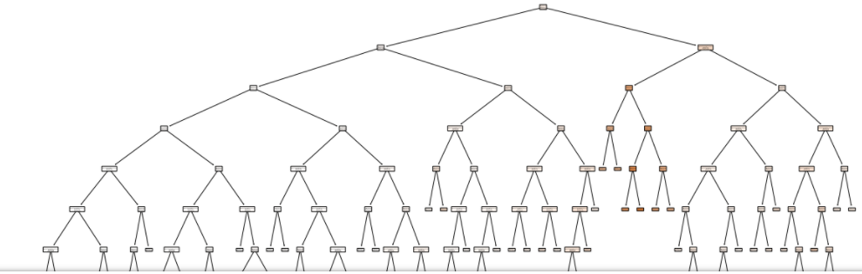
Optimising the model
A serious problem with decision trees is overfitting – the model tightly fits to the training data, making it inaccurate to predict outcomes for untrained data.
Proven by massive decision tree output, R squared equals 1 and RMSE equals 0.
Solved by pruning – reducing the size by removing sections of the tree that are redundant.

Slide 15
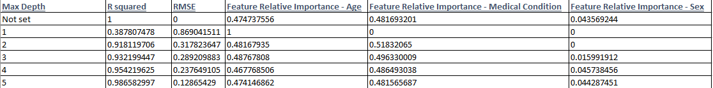
Max depth
Insights:
When Max depth is 2 or higher, R squared is very high and RMSE is low.
As Max depth increases after 2, R squared increases, while RMSE decreases.
Sex has a low feature relative importance (< 0.1), so less important risk factor.
Age and Medical Condition average around 0.5 for Feature Relative Importance.
Medical condition has a slightly larger Feature Relative Importance than Age at all max depth levels.

Slide 16
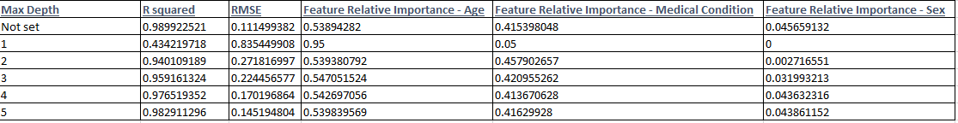
Random Forest – Max depth comparison
Insights:
Higher R squared and lower RMSE than Regression Tree Model until max depth is 5.
Similar to Regression Tree Model, Sex has a low feature relative importance (< 0.1), while Age and Medical Condition average around 0.5
However, now Age is slightly larger than Medical condition at all max depth levels.

Slide 17
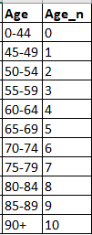

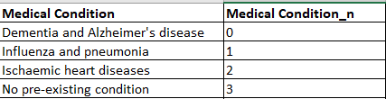
Data transformation
After changing the categorical data to numerical to run the model, we need to use a key to understand the model output.

Slide 18
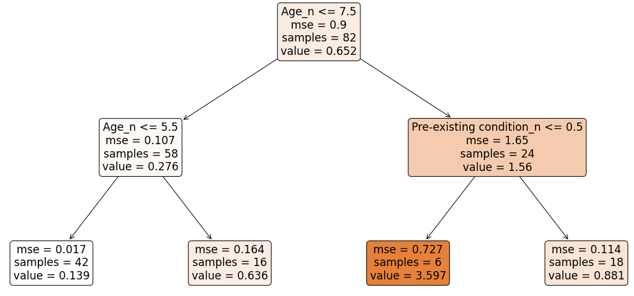
Regression Tree Model: Max depth 2

Slide 19
Interpreting the model
The root node is age below 80 with a probability of 0.652. If age is below 70, probability decreases to 0.276.
Insight: This fits with what we expect, younger the age, the lower of probability of dying to COVID-19.
For a person with an age below 80 and suffers from Dementia and Alzheimer’s disease, probability increases to 1.56.
Out of those, 6 people had the highest probability of 3.597.
Insight: This shows that a high age and a pre-existing medical condition can increase the risk of COVID-19 quite significantly.

Slide 20
Conclusion
I would reject my hypothesis that age is the only important risk factor as medical conditions are an important risk factor as well.
Employees who have or live with someone who suffers from dementia and Alzheimer’s disease; Influenza and pneumonia and Ischaemic heart diseases should be considered risky, with Dementia being more important i.e. high-risk, based on our model.

Slide 21
Organisational challenges
Problem: Would be people be upset if we prioritised certain people to return to work over them
People may want to decide their own risk
People may feel that employees who return to work sooner are more likely to keep their jobs
Solutions:
Offer as guidance and let people choose for themselves.
Emphasise phased return is purely for employee safety and does not impact future employment.
Problem: Is there enough people who can return so that the company can still be profitable?
Solution:
Calculate costs of in-office work
Figure out the minimum number of employees at each phase so that profits can be generated.
Use a survey to gauge interest from employees.

Slide 22
Follow-up questions
How can the data be improved?
Data from a longer time frame (i.e. March 2020 to March 2021) and more risk factors as input features.
If a company is global, would need worldwide data and analyse by region.
COVID-19 infection rate so looking at number of cases and spread would be useful.
Since vaccinations start from older to younger people in the UK, should older people be prioritised?
Younger people would prefer/be more suited for in-person work (e.g. stronger, more active).
Vaccines seem to be highly effective but effectiveness varies by vaccine type and the individual. Wait for data to emerge on their effectiveness.

Slide 23
References
Phased return to work 1 - https://www.nhsemployers.org/covid19/health-safety-and-wellbeing/supporting-staff-at-home-and-work/supporting-staff-to-return-to-the-workplace
Phased return to work 2 - https://www.pro-recruitment.co.uk/blog/2020/06/managing-your-employees-return-to-work-post-covid-19-lockdown#Phased%20return%20stages
Linear Regression - https://medium.datadriveninvestor.com/basics-of-linear-regression-9b529aeaa0a5 and https://sciencing.com/disadvantages-linear-regression-8562780.html
K-means clustering - https://towardsdatascience.com/understanding-k-means-clustering-in-machine-learning-6a6e67336aa1
Support Vector Machine - https://towardsdatascience.com/support-vector-machine-introduction-to-machine-learning-algorithms-934a444fca47
Decision Tree - https://scikit-learn.org/stable/modules/tree.html
Risk factors - https://www.bhf.org.uk/informationsupport/heart-matters-magazine/news/coronavirus-and-your-health/what-makes-you-at-risk-from-coronavirus
Risk - https://ourworldindata.org/mortality-risk-covid#what-do-we-know-about-the-risk-of-dying-from-covid-19
Data Source - https://www.ons.gov.uk/peoplepopulationandcommunity/birthsdeathsandmarriages/deaths/datasets/deathsinvolvingcovid19englandandwales
R- Squared - https://corporatefinanceinstitute.com/resources/knowledge/other/r-squared/
RMSE - https://www.statisticshowto.com/probability-and-statistics/regression-analysis/rmse-root-mean-square-error/
Random Forest - https://towardsdatascience.com/understanding-random-forest-58381e0602d2
Decision Tree Python - https://www.youtube.com/watch?v=q90UDEgYqeI&t=3430s
Regression Tree Explained - https://www.youtube.com/watch?v=g9c66TUylZ4&t=235s
Sklearn Regression Tree - https://scikit-learn.org/stable/modules/generated/sklearn.tree.DecisionTreeRegressor.html

